Slide 1
Sign Language Recognition
by
VARUN - 02070206
SANJANA - 02075870
TILAK - 02020599
GHANASHYAM -02070793
Under the Guidance of
Prof. AshokKumar R Patel
Submitted to the Department of Computer Science.
University Of Massachusetts
North Dartmouth,Massachusetts

Slide 2
Introduction
Whether it takes the form of audible, visual, or visual expression, communication is essential to life in the world.
﻿The communication among the deaf and dumb people is carried by text and visual expressions.
﻿Gestural communication is always in the scope of confidential and secure communication.
When communicating, the human hands and facial features have a significant impact on how people convey their thoughts.

Slide 3
Problem Statement
In real life, it might be difficult to understand the precise context of a deaf or dumb person's symbolic expressions unless it is correctly described.

Slide 4
Contributions
Data Collection: Tilak and Ghanshyam.
Training and evaluation of model : Varun and Sanjana
Live Demo : Varun
PPT: Tilak, Sanjana and Ghanshyam

Slide 5



Goal
Extract Holistic keypoints
Train an LSTM DL model
Make a real time predictions using sequences

Slide 6
How it works
Collect
Train
Perform
Collect keypoints from mediapipe holistic
Train a deep neural network with LSTM layers for sequences.
Perform real time sign language detection using OpenCV

Slide 7
Steps
Import and Install Dependencies
Keypoints using MP Holistic
Extract Keypoints Values
Setup Folders for Collection
Collect Keypoints Values for Training and Testing
Preprocess Data and Create Labels and Features
Build and Train LSTM Neural Network

Slide 8
Make Prediction
Save weights
Evaluation Using Confusion Matrix and Accuracy
Test in Real Time

Slide 9






Modeling Tools/Libraries

Slide 10
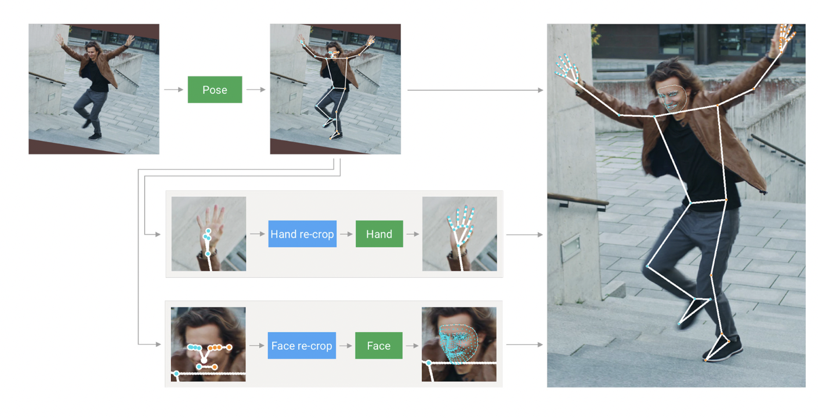
Mediapipe Holistic Pipeline
The Media Pipe Holistic pipeline integrates separate models for pose, face and hand components, each of which are optimized for their particular domain.
The pipeline is implemented as a MediaPipe graph that uses a holistic landmark subgraph from the holistic landmark module and renders using a dedicated holistic renderer subgraph. The holistic landmark subgraph internally uses a pose landmark module , hand landmark module and face landmark module.

Slide 11
Model : LSTM Neural Network
LSTMs deal with both Long Term Memory (LTM) and Short Term Memory (STM) and for making the calculations simple and effective it uses the concept of gates.
Forget Gate: LTM goes to forget gate and it forgets information that is not useful.
Learn Gate: Event ( current input ) and STM are combined together so that necessary information that we have recently learned from STM can be applied to the current input.
Remember Gate: LTM information that we haven’t forget and STM and Event are combined together in Remember gate which works as updated LTM.
Use Gate: This gate also uses LTM, STM, and Event to predict the output of the current event which works as an updated STM.

Slide 12
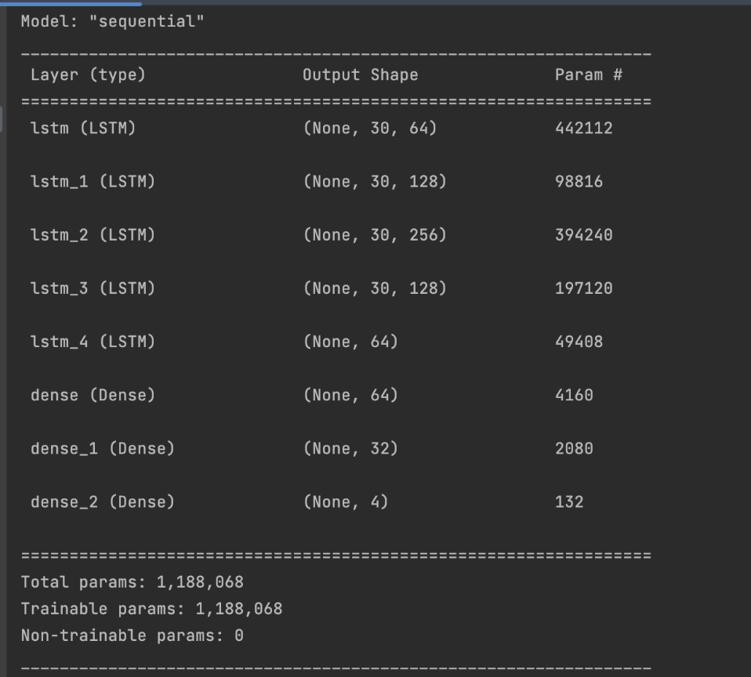
Training LSTMs removes the problem of Vanishing Gradient ( weights become too small that under-fits the model ), but it still faces the issue of Exploding Gradient ( weights become too large that over-fits the model ).
Split sequentially (Train: 80%, Test: 20%)

Slide 13
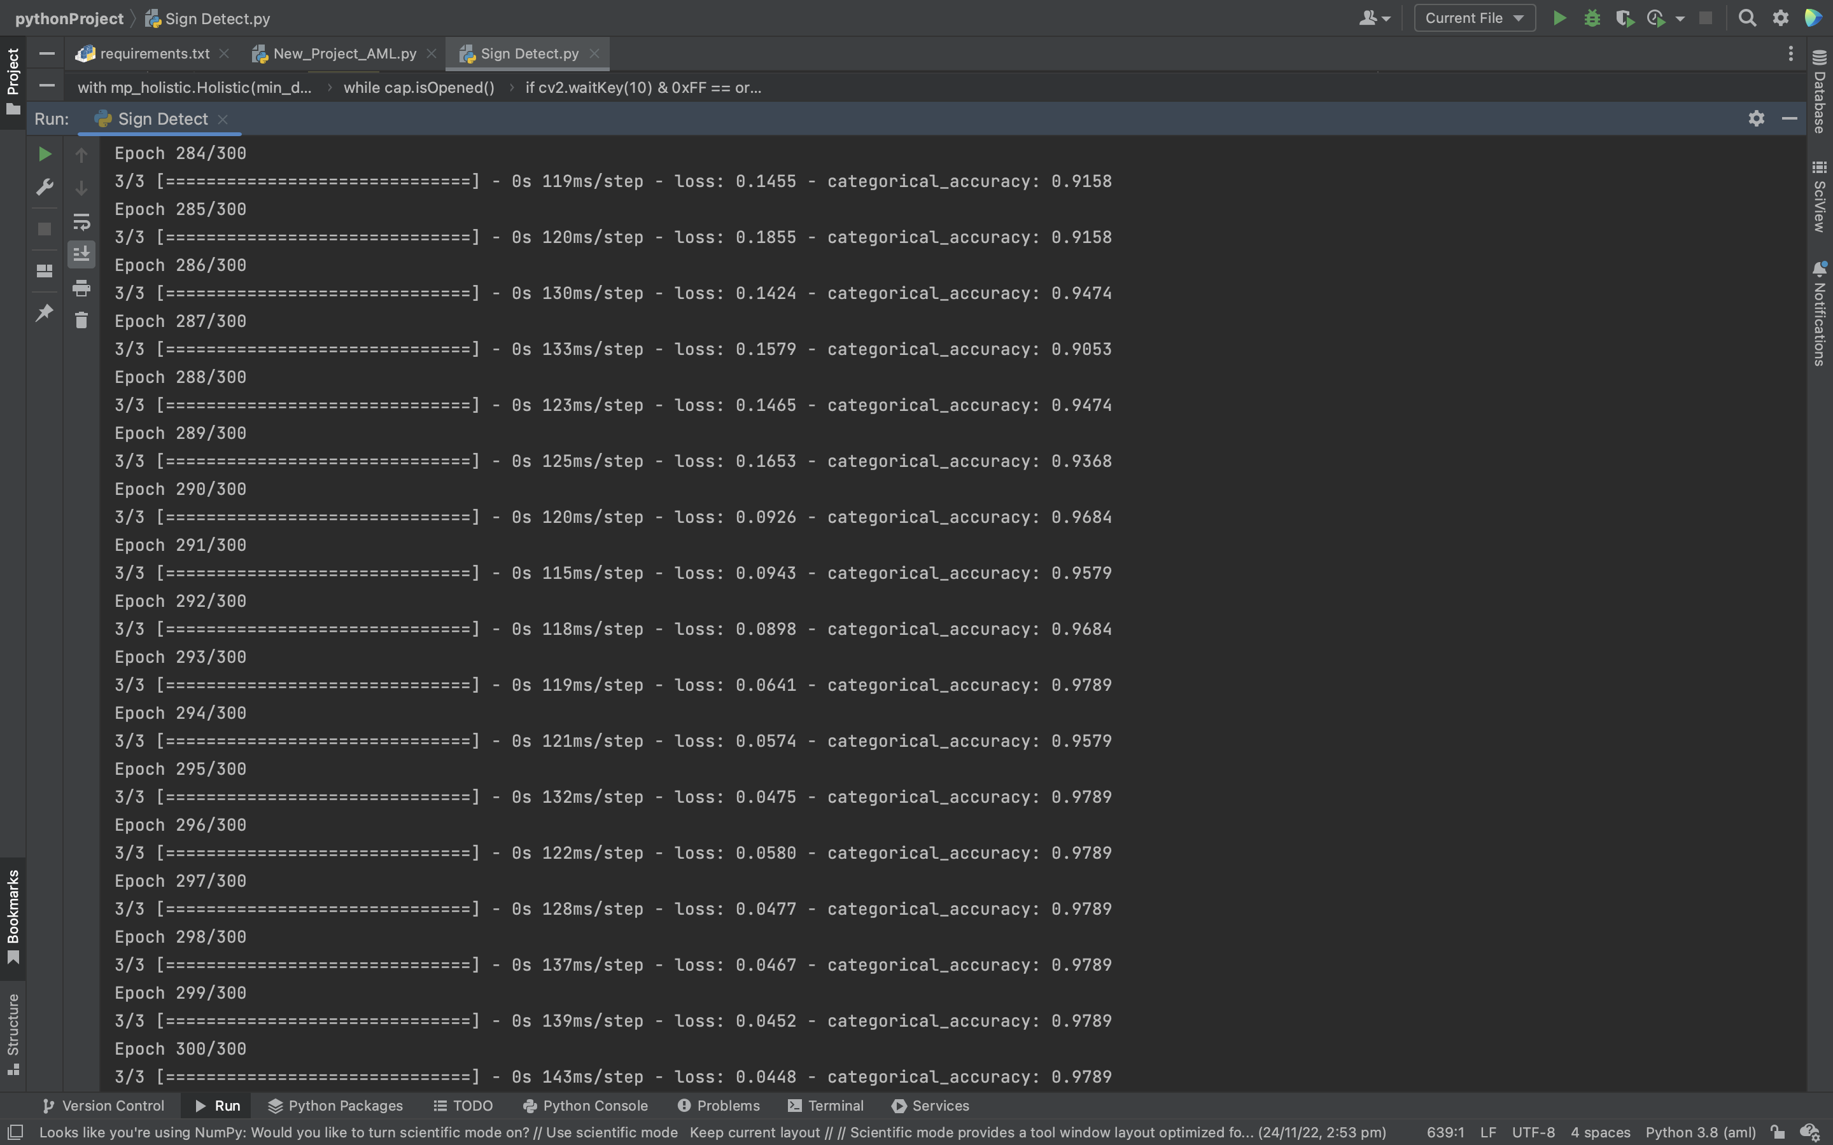
Training the dataset
The model is initially fit on a training data set, which is a set of examples used to fit the parameters of the model. The model trained on the training data set using a learning method. In practice, the training data set often consists of pairs of an input vector (or scalar) and the corresponding output vector (or scalar), where the answer key is commonly denoted as the target (or label).

Slide 14
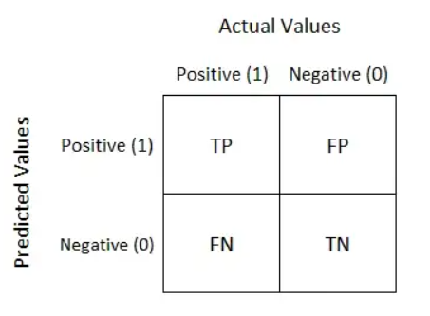
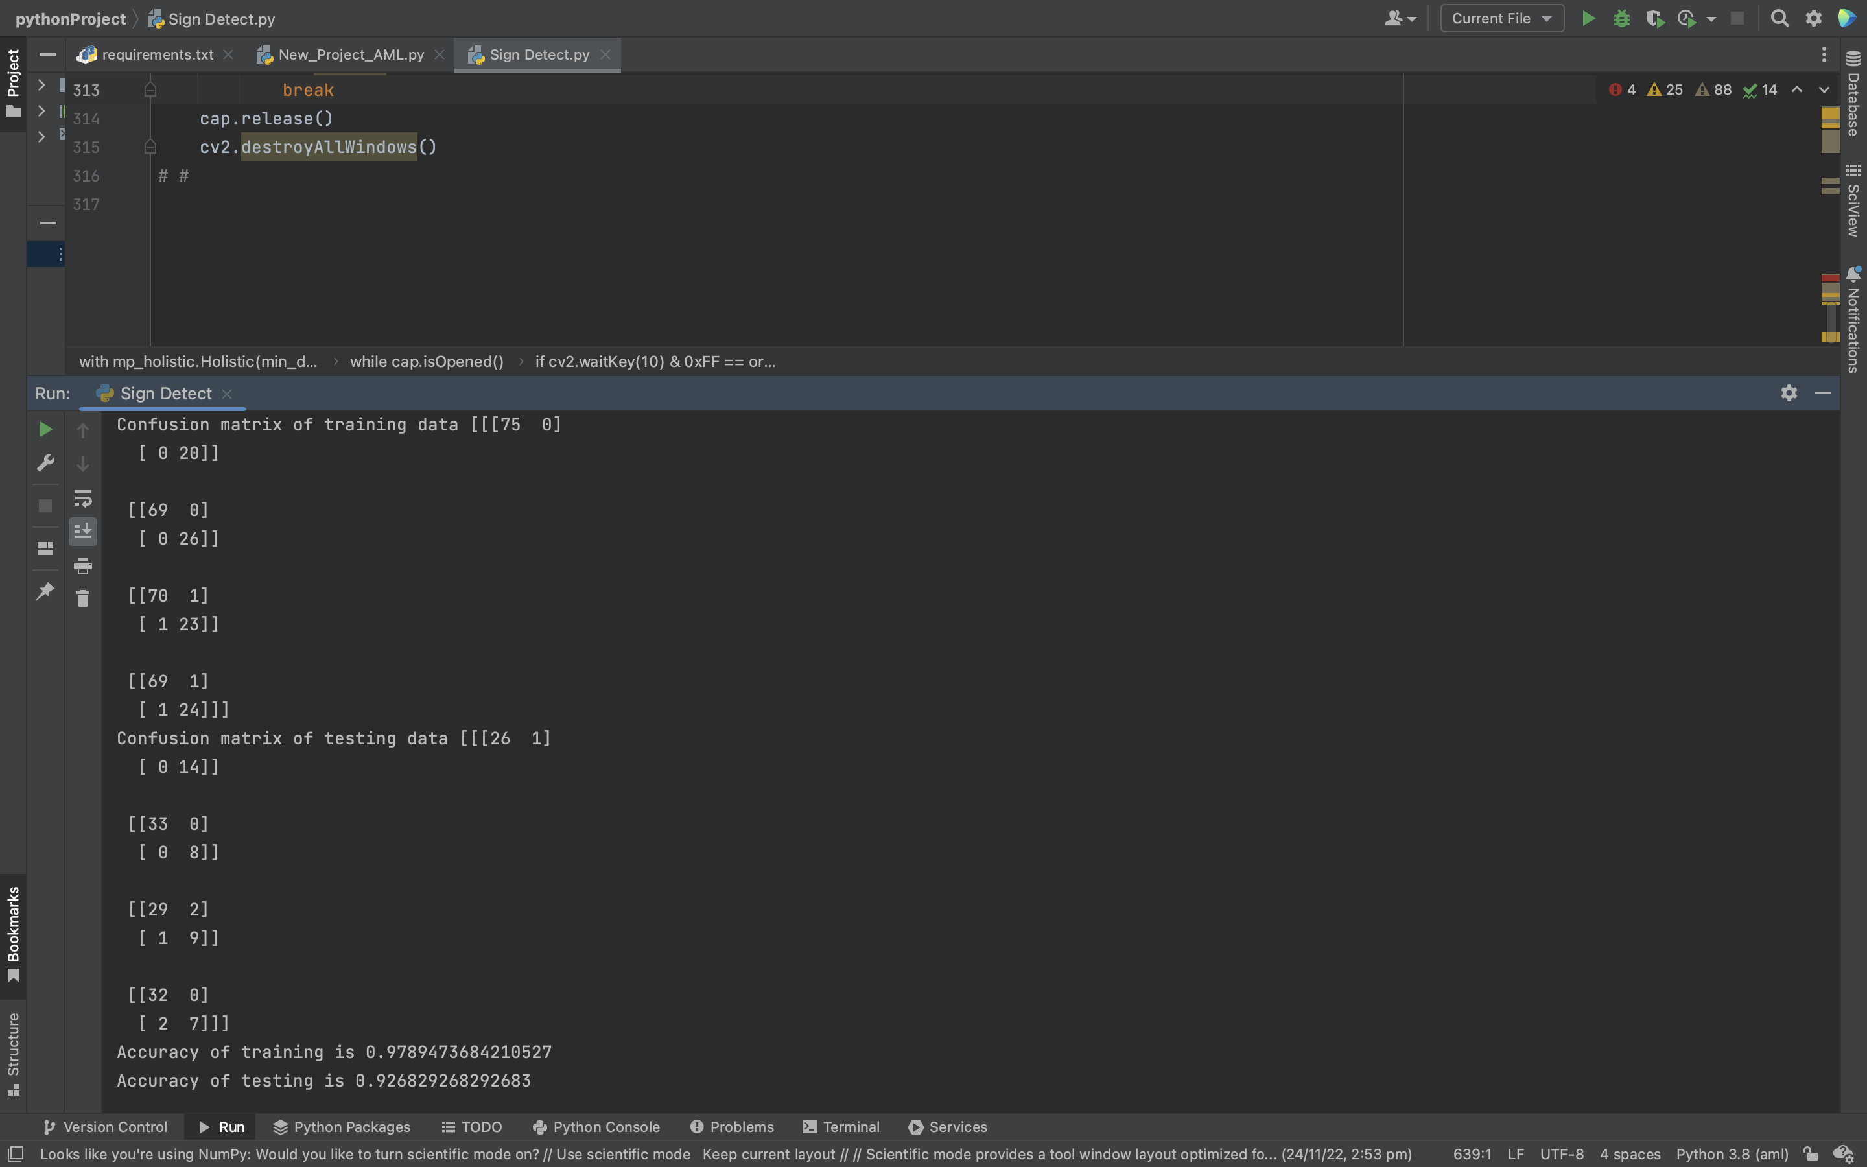
Confusion Matrix
Confusion Matrix is a performance measurement for machine learning classification problem where output can be two or more classes. It is a table with 4 different combinations of predicted and actual values.

Slide 15
Screenshots

Slide 16
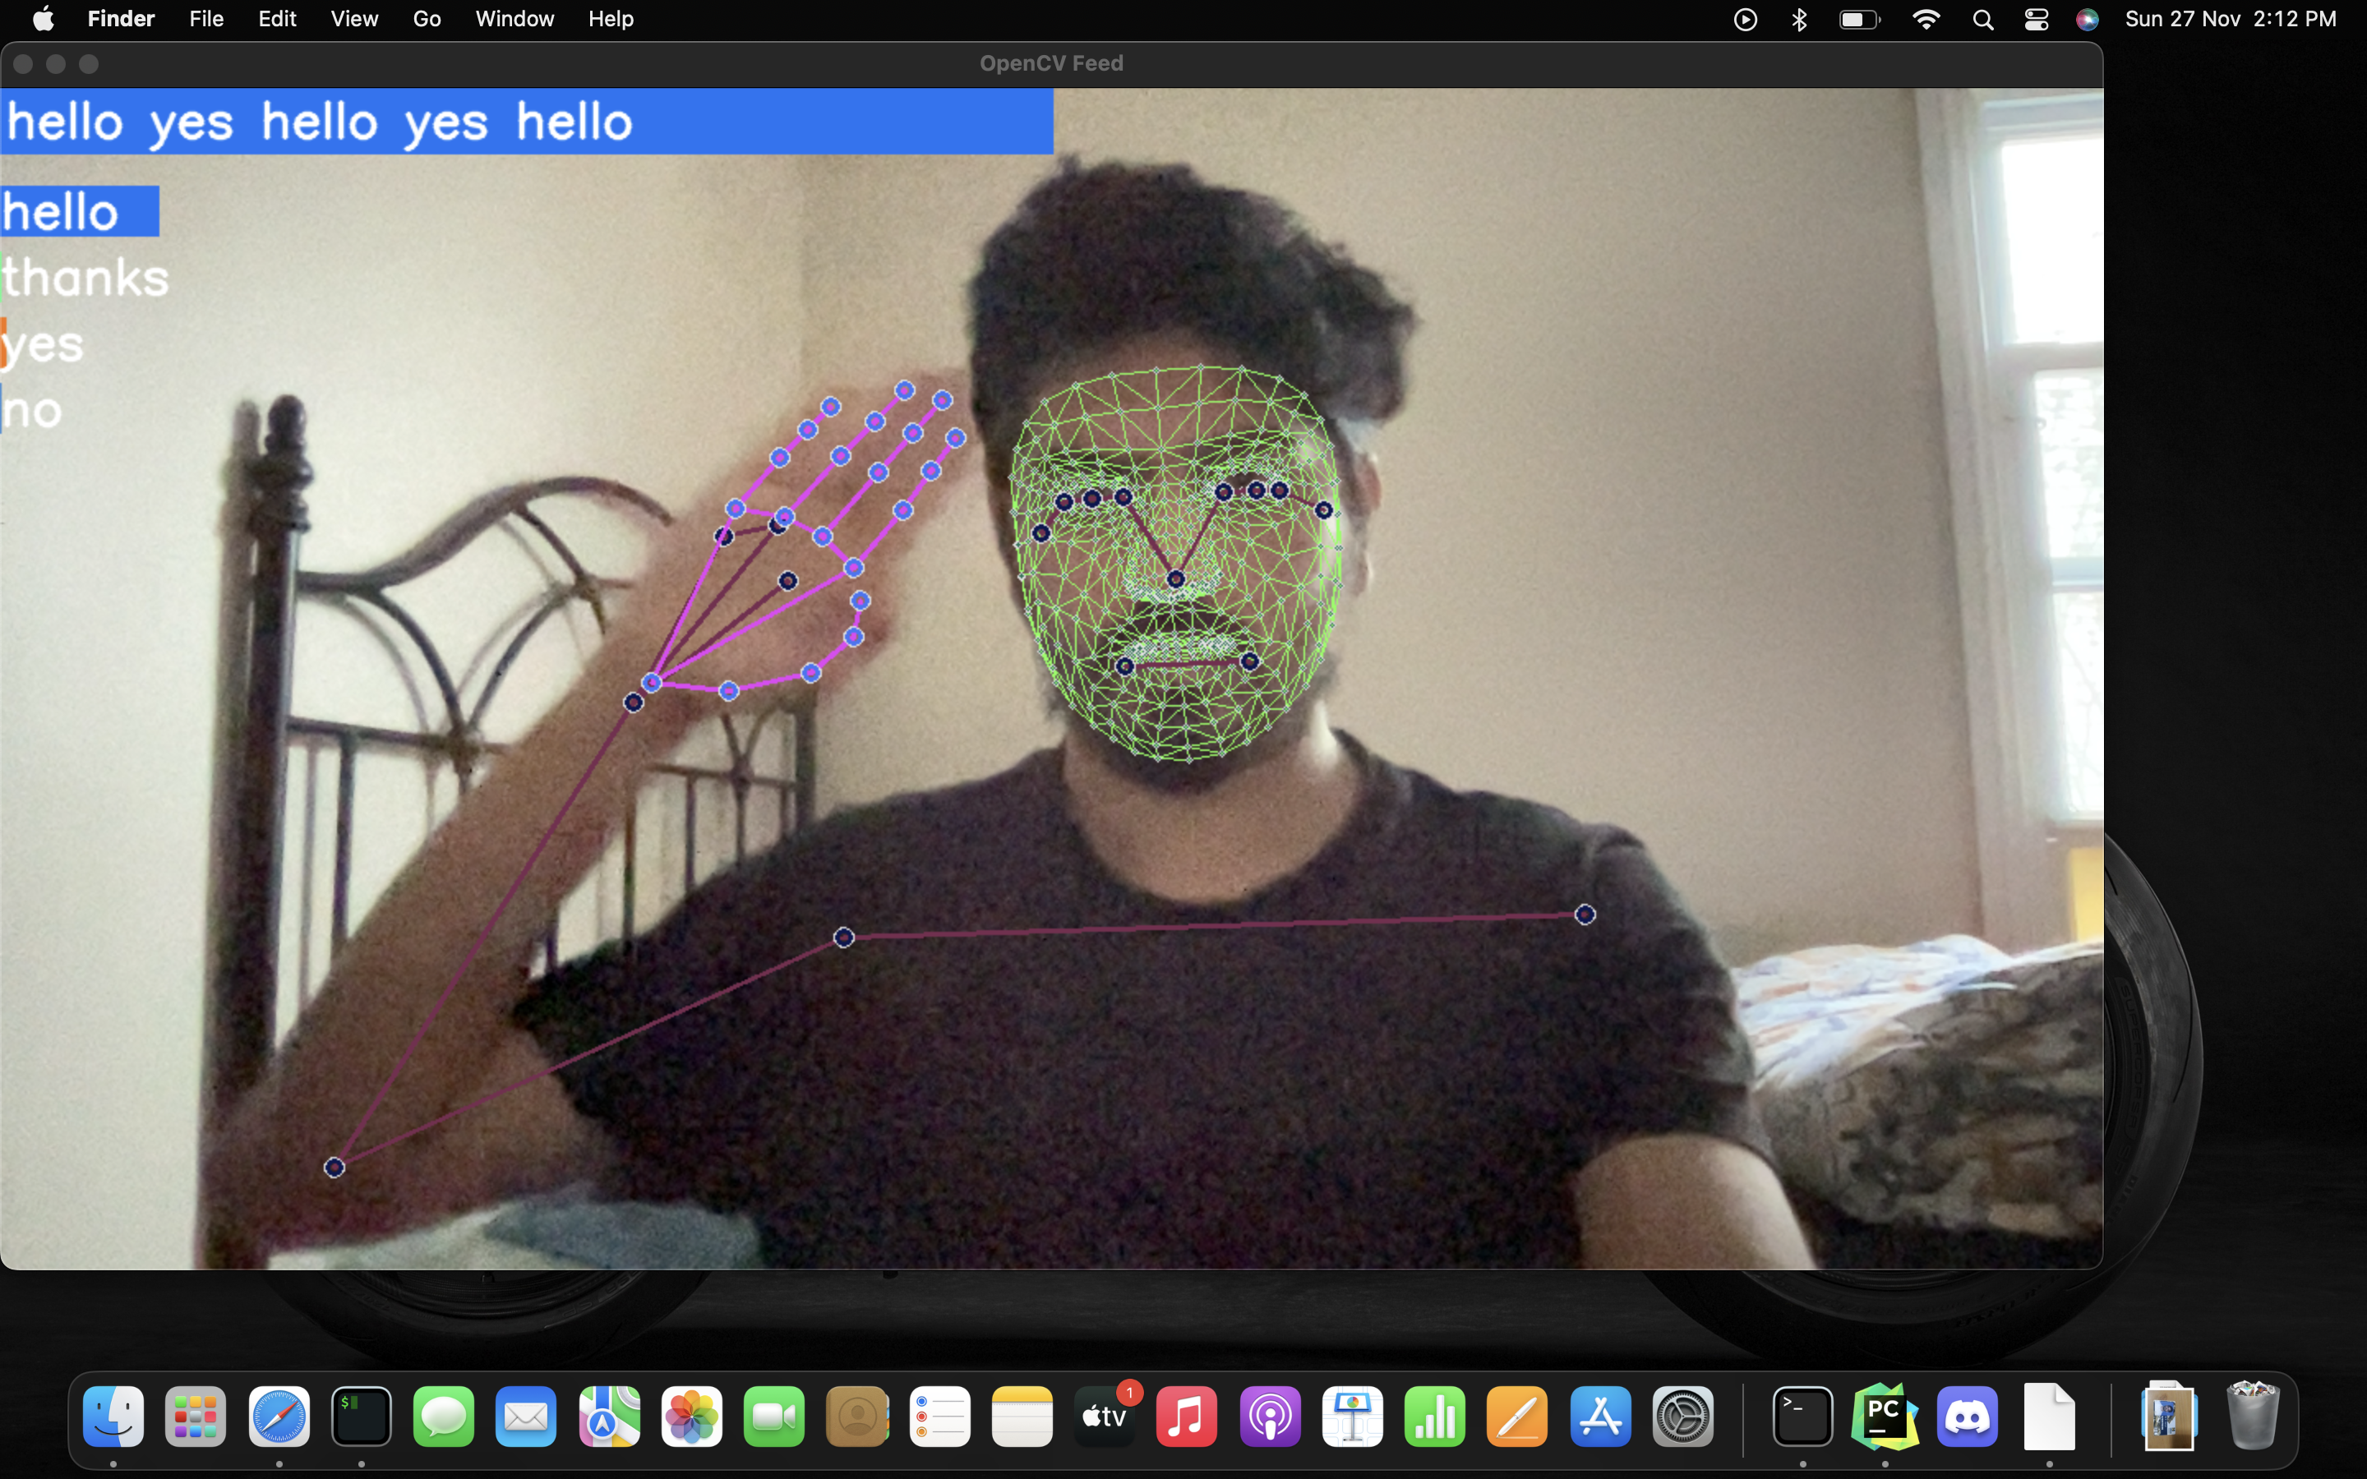
Hello

Slide 17
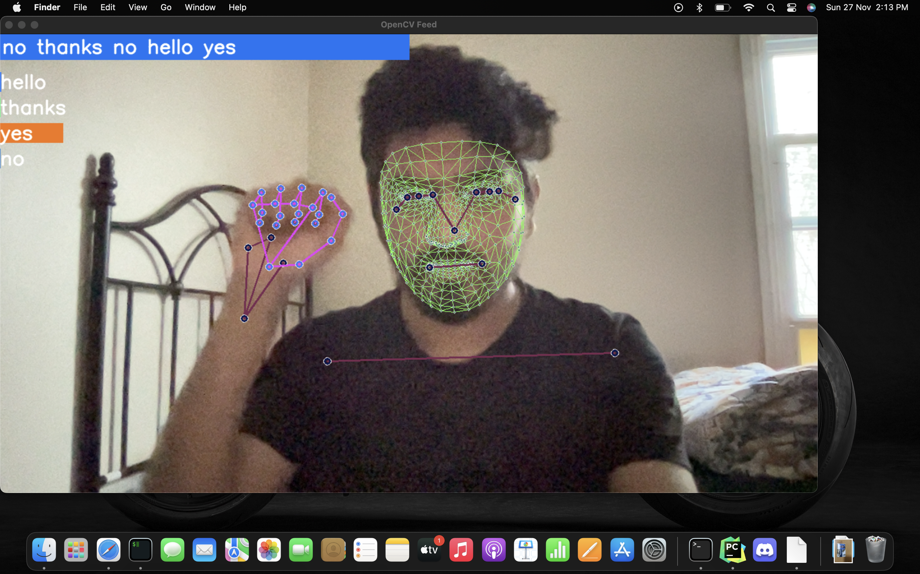
Yes

Slide 18
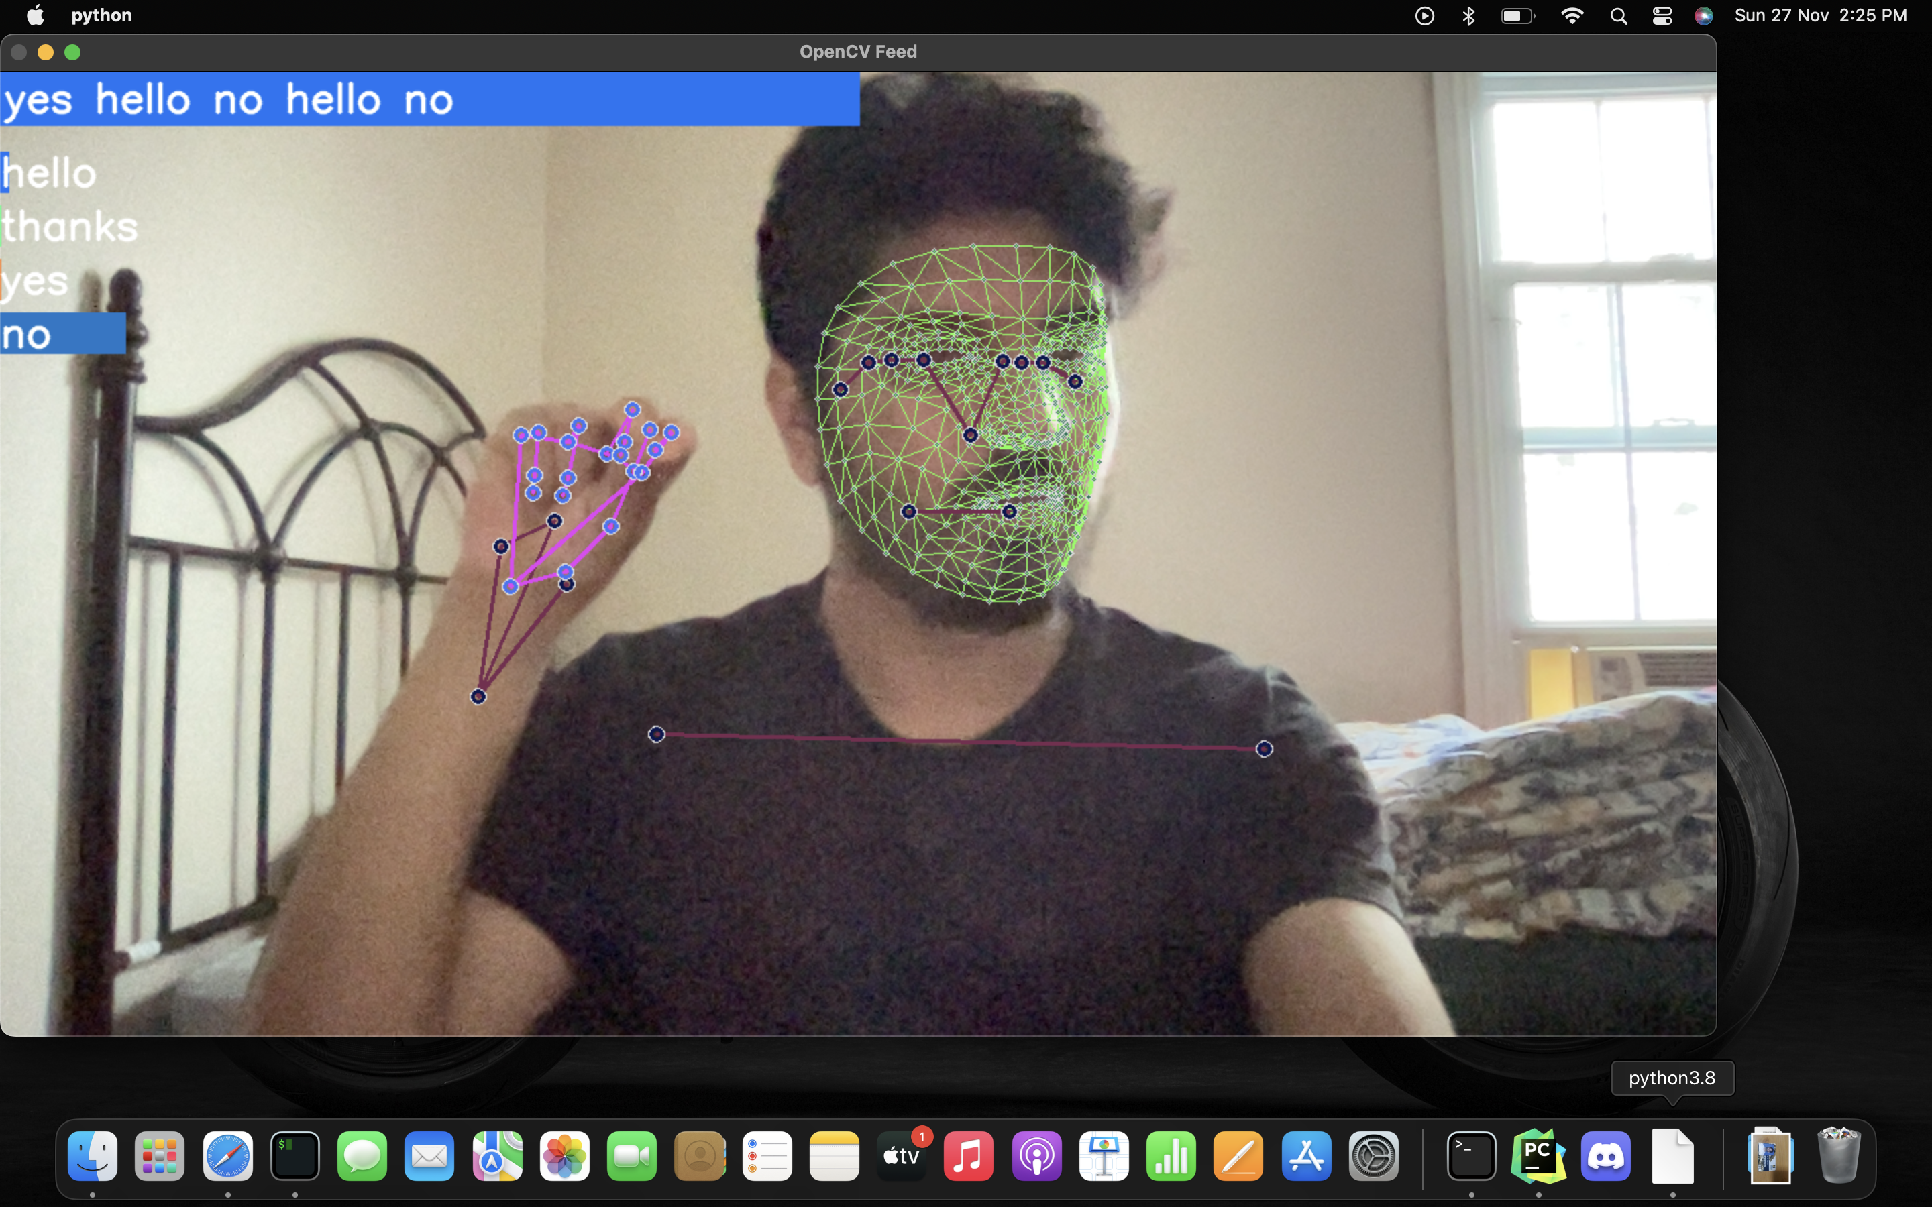
No

Slide 19
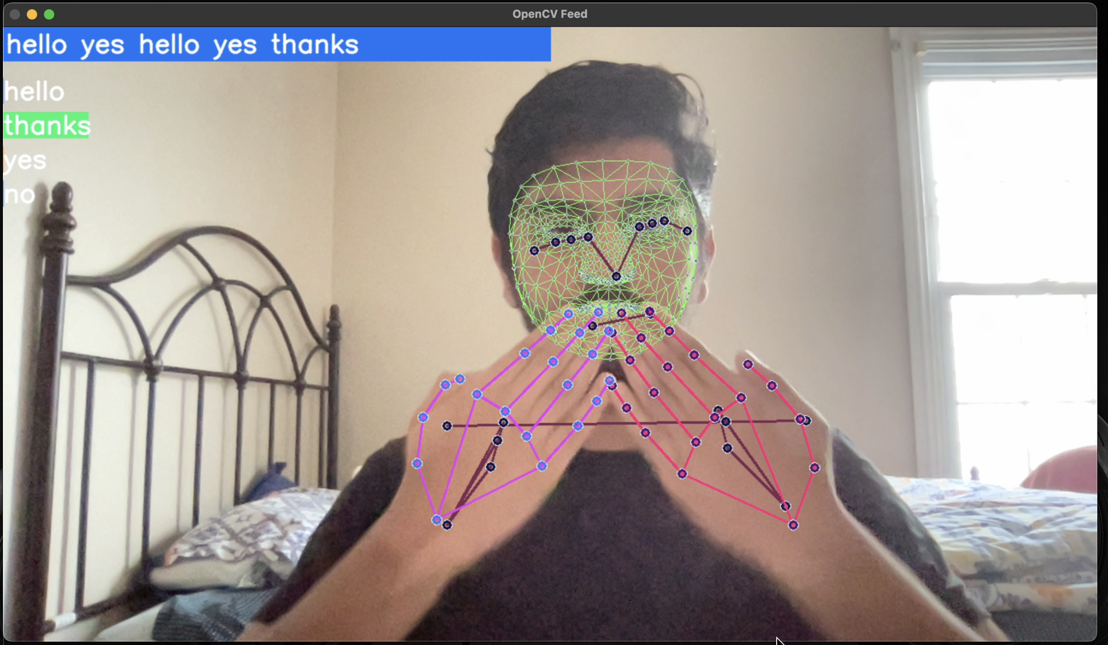
Thanks

Slide 20


Results
Accuracy of Training is 0.97
Accuracy of Testing is 0.92

Slide 21
References
LSTM: https://www.analyticsvidhya.com/blog/2021/01/understanding-architecture-of-lstm/
Mediapipe: https://google.github.io/mediapipe/solutions/holistic.html
OpenCV : https://docs.opencv.org/4.6.0/
Tensorflow : https://www.tensorflow.org/api_docs/python/tf/keras/layers/LSTM

Slide 22
Thank You

